Slide 1
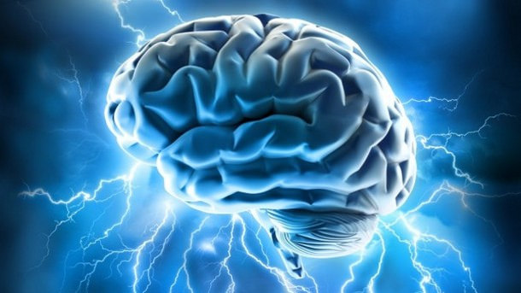

Theory of Mind (ToM)
[Professor Name]
[Class and Section Number]
Notes:
Classroom Recommendations: This topic may be taught in one long class period (75-90 minutes) or two short class periods (50-60 minutes each). Dividing the topic into two class periods would enable more in-depth discussion of each of the components of theory of mind. When teaching this as a two-class unit, it is recommended to end the first class after reviewing the hierarchical organization of the component processes of ToM.
Overview: One of the most remarkable human capacities is to perceive and understand mental states. This capacity, often labeled “theory of mind,” consists of an array of psychological processes that play essential roles in human social life. We review some of these roles, examine what happens when the capacity is deficient, and explore the many processes that make up the capacity to understand minds.
Technical Note: These slides may contain simple click animation so that you can focus students’ attention on a particular question, a selection of text, or an image and not have them be distracted by reading ahead. You can either preview the sequence of animation by going through the slides in slideshow view, visiting the animations tab, or reviewing the slide notes. In the notes you will see a cue - (Click) – that corresponds to each animation.
You may also find hyperlinks to outside videos at various places in the slides. These hyperlinks are embedded in text and indicated by color and in the notes section.

Slide 2
Learning Objectives
Explain what ToM is.
Enumerate the many domains of social life in which ToM is critical.
Describe some characteristics of how autistic individuals differ in their processing of others’ minds.
Describe and explain some of the many concepts and processes that comprise the human understanding of minds.
Have a basic understanding of how ordinary people explain unintentional and intentional behavior.
Notes:
This slide outlines the learning objectives of the module.

Slide 3
Warm-Up
Heider and Simmel (1944) video clip
Describe what is happening in this movie.
Notes:
The purpose of this slide is to introduce a warm-up activity that will get students thinking about the Theory of Mind concepts.
Begin by showing students a video used in Heider and Simmel (1944), which shows geometric shapes moving; participants in the study and most people who view the video tend to automatically view the animated geometric shapes’ actions in terms of theory-of-mind concepts (such as goals, intentions, or traits). The video can be found at: https://www.youtube.com/watch?v=76p64j3H1Ng
(Click): Describe what is happening in the movie
Ask students to write down what happened in the video. Use this as a jumping off point to discuss how humans have a tendency to focus on the underlying mental causes of behavior and not to see actions as random.
Reference:
Heider, F., & Simmel, M. (1944). An experimental study of apparent behavior. American Journal of Psychology, 57, 243-259.

Slide 4
Overview
What Is Theory of Mind (ToM)?
Why Do We Need ToM?
How Is ToM Different in Individuals with Autism?
What Processes Comprise ToM?
How Do People Explain Others’ Behavior?
Notes:
This slide shows all major topics to be covered as well as significant sub-topics (sub topics that have at least 1 slide of their own). It helps students see the “big picture” of your lecture, which makes it easier to make connections between topics.

Slide 5

What is ToM?
Understanding and reasoning about other people’s minds
What do you think she is thinking or feeling?
Notes:
The purpose of this slide is to define the concept of Theory of Mind and to complete an activity that solidifies this concept.
(Click): Understanding and reasoning about other people’s minds.
Theory of mind is understanding and reasoning about other people’s minds. It’s sometimes also called mind reading or mentalizing because it involves interpreting what is happening in another person’s mind. We engage in it all the time. And for most people it happens automatically.
Let’s engage in a bit of theory of mind reasoning-
(Click): What do you think is going on with this woman? What do you think she is thinking or feeling?
Let students answer and then explain how they are looking at external cues to figure out her internal state.

Slide 6
Overview
What Is Theory of Mind (ToM)?
Why Do We Need ToM?
How Is ToM Different in Individuals with Autism?
What Processes Comprise ToM?
How Do People Explain Others’ Behavior?
Notes:
Mid-Lecture Overview - So, we engage in theory of mind automatically, pretty much all of the time. Let’s talk about why this matters.

Slide 7
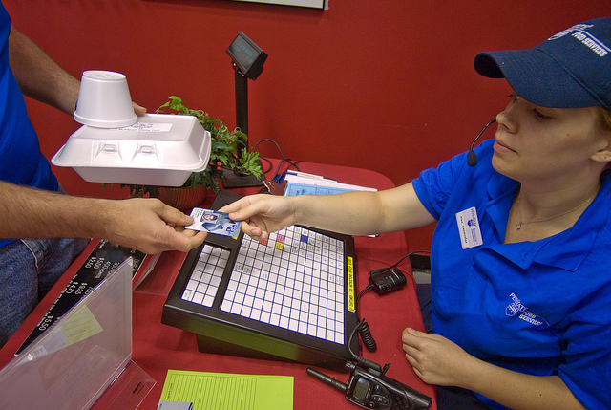
Why do we need ToM?
It’s necessary to understand why people do what they do
Notes:
This slide describes the purpose of the Theory of Mind.
(Click): It’s necessary to understand why people do what they do
(Use example from text): ToM is necessary to understand why people do what they do. This helps us make sense of what is going on in the world around us. For example, what is happening here (i.e. on the image on this slide)?
If you didn’t have ToM, then it would seem as though people were moving around randomly in unpredictable ways. You wouldn’t know why they were behaving that way, or what to expect would happen next, and you wouldn’t know how they are likely to respond to you.
Most people (neurotypical people) mentalize automatically, and are generally pretty good at understanding and predicting the mental states of others. However, in some atypical populations, there is a specific deficit in theory of mind. Specifically, the group that I am talking about are individuals who have autism.

Slide 8
Overview
What Is Theory of Mind (ToM)?
Why Do We Need ToM?
How Is ToM Different in Individuals with Autism?
What Processes Comprise ToM?
How Do People Explain Others’ Behavior?
Notes:
Mid-Lecture Overview - Let’s talk a bit about autism and how ToM is different in people with autism

Slide 9
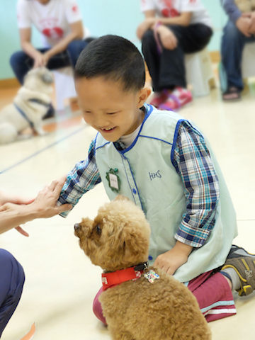
How is ToM different in individuals with autism?
The Autism Spectrum
Varied severity
Varied symptoms
A Common Symptom:
Deficits in ToM
Notes:
The purpose of this slide is to discuss the individual differences in the Theory of Mind.
(Click): The autism spectrum
Explain that there is a spectrum of autism disorders.
(Click): Varied severity
Explain that individuals with autistic spectrum disorders vary greatly from one another in terms of the severity of their symptoms – some individuals are labeled as “high functioning” because their symptoms are not very severe.
(Click): Varied symptoms
Others have much more severe symptoms, which can seriously limit their ability to function in daily life.
Explain that individuals with autistic spectrum disorders vary greatly from one another in terms of the symptoms that they have. They show various combinations of symptoms, including problems with sensory processing, language, and self-control.
(Click): A common symptom
(Click): Deficits in ToM
One of the common symptoms of autism is a deficit in ToM… while neurotpyical people automatically interpret others behavior in terms of underlying mental processes, individuals with autism have trouble figuring out what is the underlying mental cause. As you can imagine, this leads to difficulties in social settings.

Slide 10
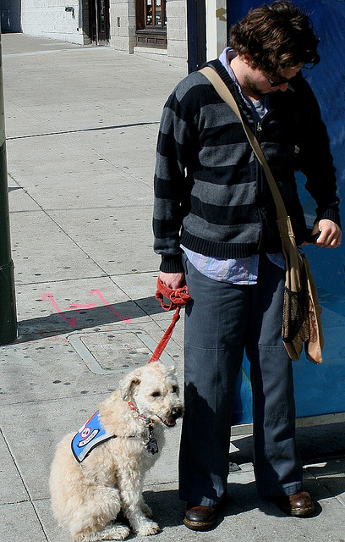
Video and Discussion
My Life with Asperger's: Clip
Impact on Individuals’ Social Lives
Temple Grandin
Notes:
The purpose of this slide is to continue discussion on individual variations in the Theory of Mind.
Show a video illustrating the challenges in people processing faced by individuals with autism. Show the first 5:47 of My life with Asperger's: Daniel Wendler at TEDxUniversityofArizona (https://www.youtube.com/watch?v=B-xgdqNtcDI).
For more on the people processing problems faced by individuals with autism see the Noba ToM module –
http://nobaproject.com/modules/theory-of-mind#autism-and-theory-of-mind
Discussion Questions:
(Click): Impact on individuals’ social lives
How do deficits in theory of mind processing impact the social lives of individuals with autism spectrum disorders?
Discuss the numerous facets of life where mind reading is required (family, school, work, etc.)
(Click): Temple Grandin
Temple Grandin is a well-known activist and author who has autism. She has described herself as “an anthropologist from Mars.” Why do you think she uses this phrase to describe her experiences in social interactions?
Use students’ responses as a way to discuss differences in people processing between individuals who do and do not have autism.

Slide 11
Overview
What Is Theory of Mind (ToM)?
Why Do We Need ToM?
How Is ToM Different in Individuals with Autism?
What Processes Comprise ToM?
How Do People Explain Others’ Behavior?
Notes:
Mid-Lecture Overview

Slide 12
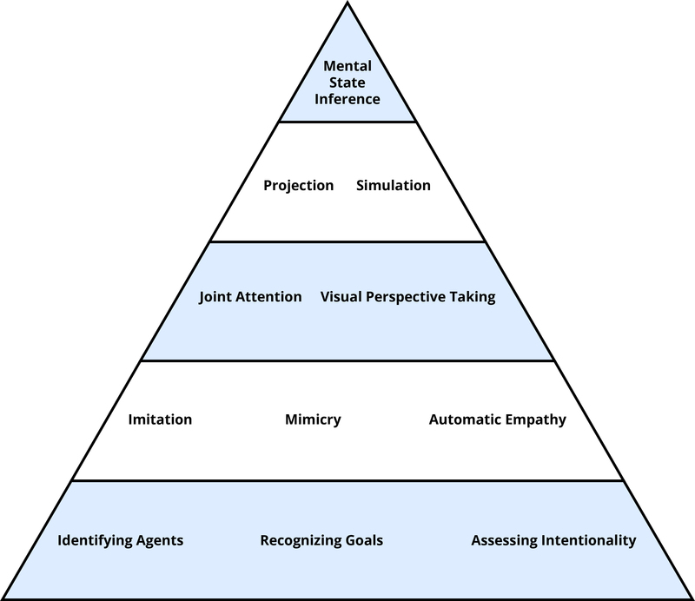
Hierarchy of ToM Processes
Notes:
Explain how ToM is a multifaceted process and that component parts can be organized hierarchically.
Theory of mind is comprised of lots of different cognitive processes, which can be arranged into a hierarchy. At the lowest level are processes that are achieved very early in development and that may be shared by other species. As you move higher up the hierarchy, the processes are achieved later in development and become more exclusive to humans.
From the text-
“The Mental Processes Underlying Theory of Mind
The first thing to note is that “theory of mind” is not a single thing. What underlies people’s capacity to recognize and understand mental states is a whole host of components—a toolbox, as it were, for many different but related tasks in the social world (Malle, 2008). Figure 1 shows some of the most important tools, organized in a way that reflects the complexity of involved processes: from simple and automatic on the bottom to complex and deliberate on the top. This organization also reflects development—from tools that infants master within the first 6–12 months to tools they need to acquire over the next 3–5 years. Strikingly, the organization also reflects evolution: monkeys have available the tools on the bottom; chimpanzees have available the tools at the second level; but only humans master the remaining tools above. Let’s look at a few of them in more detail.”
For greater detail on each level of the hierarchy see-
http://nobaproject.com/modules/theory-of-mind#agents-goals-and-intentionality
http://nobaproject.com/modules/theory-of-mind#imitation-synchrony-and-empathy
http://nobaproject.com/modules/theory-of-mind#joint-attention-visual-perspective-taking
http://nobaproject.com/modules/theory-of-mind#projection-simulation-and-the-specter-of-egocentrism
http://nobaproject.com/modules/theory-of-mind#explicit-mental-state-inference

Slide 13
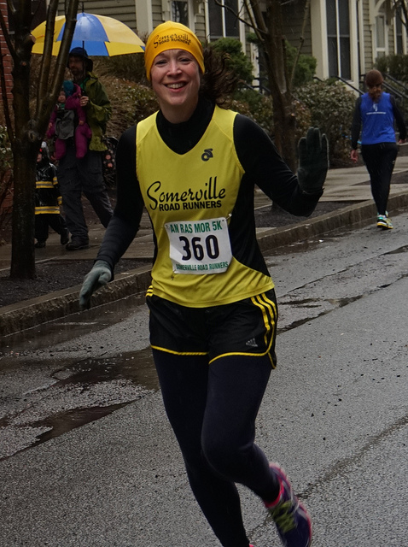
Recognizing Agents and Goals
Recognizing Agents
  Something that can act on its own
    Examples?
Cues to agency
Agents Have Goals
Motivations for actions
Notes:
The purpose of this slide is to introduce the concepts of agents and what distinguishes them from non-agents.
(Click): Recognizing agents
Explain what an agent is.
(Click): Something that can act on its own
(Click): Examples?
Give an example (e.g., the person in the image on this slide is an agent, so is a squirrel pursuing a nut)… ask for and discuss examples
(Click): Cues to agency
Ask how they know something is an agent. Discuss answers in terms of cues (self-propelled, has eyes, responding contingently).
(Click): Agents have goals
(Click): Motivations for actions
Talk about how agents’ actions are motivated by goals… ask what is the goal of the person in the picture. Explain that these two points are the foundation for TOM: appreciating that some things have agency and some things don’t (e.g., people vs. rocks – if a rock moves it’s not because it wanted to)… and appreciating that the actions of agents are motivated by some kind of goals. Explain that infants have this ability.

Slide 14

Intentionality
Understanding the difference between…
  Intentional actions: skillful, directed actions consistent with goals (examples?)
  Unintentional actions: accidental or lucky actions that may or may not be consistent with goals (examples?)
Notes:
The purpose of this slide is to discuss intentionality in the scope of agents and goals.
(Click): Understanding the difference between…
(Click): Intentional actions: skillful, directed actions consistent with goals (examples?)
Explain the difference between understanding goals and understanding intentionality (more complex: requires skill and knowledge in addition to matching the wished-for outcome).
(Click): Unintentional actions: accidental or lucky actions that may or may not be consistent with goals (examples?)
Discuss the difference between intentional and unintentional actions and ask for/discuss examples of each (can use examples from text)
You can also use the example of a rock climber… the goal is to reach the top… if she reaches up and moves up to the next hold successfully we would call that intentional, if she reaches up but slips off we would call that unintentional. You could tie in developmental research about the age when children respond differently to intentional vs. unintentional actions which is outlined below.
Developmental Research on intentional vs. Unintentional Actions:
Research has found that children as young as 14-18 months are more likely to imitate actions that seem to be intentional (e.g., actions followed by an adult saying ‘there’), than actions that seem to be unintentional (e.g., actions followed by an adults saying ‘oops!’). Thus, understanding intentionality seems to be one of the earliest achievements in theory of mind development.
For additional information please see the resources below:
http://www.researchgate.net/profile/Nameera_Akhtar/publication/40852285_Fourteen-_to_18-month-old_infants_differentially_imitate_intentional_and_accidental_actions/links/55255ccc0cf295bf160e721c.pdf
http://woodwardlab.uchicago.edu/Publications_files/Infants%20dstngsh%20prpsfl%20and%20nonprpsfl.pdf

Slide 15

Imitation, Synchrony, & Empathy
Imitation
Watch and model actions
Can be automatic (mimicry) or intentional
Synchrony
When two people mutually mimic one another
Synchrony and liking
Automatic empathy
Notes:
The purpose of this slide is to introduce the topics of imitation, synchrony and empathy.
(Click): Imitation
(Click): Watch and model actions
Discuss definition of imitation - Imitation is the human tendency to carefully observe others’ behaviors and do as they do—even if it is the first time the perceiver has seen this behavior.
(Click): Can be automatic (mimicry) or intentional
Explain that it can be automatic or intentional. Automatic imitation is called mimicry.
(Click): Synchrony
(Click): When two people mutually mimic one another
Sometimes people start to mutually mimic one another - this is called synchrony - more often happens if they like one another
(Click): Synchrony and liking
When someone mimics us, we rate them as more likable
(Click): Automatic empathy
Another interesting consequence… when we mimic someone else’s body language and facial expressions, we start to feel hints of their emotional state. Ask why this is helpful in social interactions.
From the ToM module-
“Automatic empathy builds on imitation and synchrony in a clever way. If Bill is sad and expresses this emotion in his face and body, and if Elena watches or interacts with Bill, then she will subtly imitate his dejected behavior and, through well-practiced associations of certain behaviors and emotions, she will feel a little sad as well (Sonnby-Borgström, Jönsson, & Svensson, 2003). Thus, she empathizes with him—whether she wants to or not. Try it yourself. Type “sad human faces” into your Internet search engine and select images from your results. Look at 20 photos and pay careful attention to what happens to your face and to your mood. Do you feel almost a “pull” of some of your facial muscles? Do you feel a tinge of melancholy?”

Slide 16

Joint Attention
When two people are simultaneously focusing on the same thing
  Critical for word learning
Notes:
The purpose of this slide is to discuss the concept of joint attention.
(Click): When two people are simultaneously focusing on the same thing
Explain that joint attention occurs when two people are thinking about and focusing on the same thing (as are the three people looking at the person in the black shirt).
(Click): Critical for word learning
In order for children to learn a new word, both they and the person saying the new word must be paying attention to and thinking about the same thing. For example, if a parent is at the zoo with their child, and they say, “What a pretty giraffe” but the child is looking over at the elephant, the child may incorrectly map the word “giraffe” onto the “elephant”. Studies have found that young children are discriminating word learners - they will only map words onto objects if they and the speaker are both actually looking at the object when the new word is said.

Slide 17

Visual Perspective Taking
Taking on another person’s point of view
  Requires mental rotation
Egocentrism
Inability understand another person’s perspective (physical or mental)
People often overestimate how much they understand what others are thinking
Notes:
The purpose of this slide is to introduce and discuss the concept of visual perspective taking.
(Click): Taking another’s point of view
Explain that visual perspective taking is the ability to simulate what someone else would see from their point of view.
(Click): Requires mental rotation
Studies show that when we do this we are actually mentally rotating our point of view.
(Click): Egocentrism
(Click): Inability to understand another person’s perspective (physical or mental)
Could add in that this ability was studied by Piaget (using 3 mountains task):
“Method: The child sits at a table, presented in front are three mountains. The mountains were different, with snow on top of one, a hut on another and a red cross on top of the other. The child was allowed to walk round the model, to look at it, then sit down at one side. A doll is then placed at various positions of the table.
The child is then shown 10 photographs of the mountains taken from different positions, and asked to indicate which showed the dolls view. Piaget assumed that if the child correctly picked out the card showing the doll's view, s/he was not egocentric. Egocentrism would be shown by the child who picked out the card showing the view s/he saw.”
Source: http://www.simplypsychology.org/preoperational.html
He found that children under age 7 were unable to mentally rotate themselves to see things from another person’s perspective; Piaget called this egocentrism. This concept of perspective taking can also be applied at a more metaphorical level to refer to someone’s mental point of view.
(Click): People often overestimate how much they understand what others are thinking
Discuss how people often overestimate how well they understand what others think. Ask students how this might impact social interactions (romantic relationships, business interactions etc.)

Slide 18
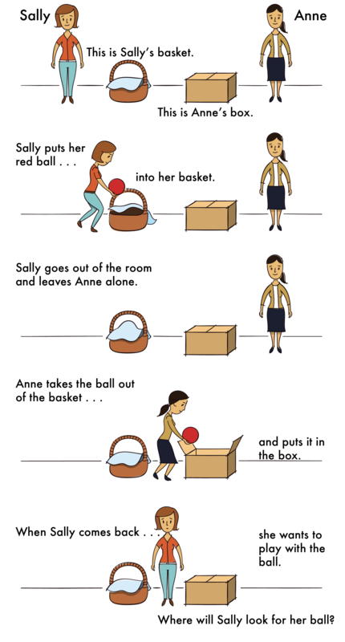
Mental State Inference
Figuring out what another person thinks or wants
Requires setting aside one’s own point of view
Tested using false-belief task
  Not passed by children until age 3 or 4
  More challenging versions of tasks difficult for adult to pass
Notes:
The purpose of this slide is to discuss mental state inference.
(Click): Figuring out what another person thinks or wants
Explain what mental state inference is - trying to infer the other person’s thoughts, desires, emotions.
(Click): Requires setting aside one’s own point of view
Explain that it can be difficult because you have to set aside what you know/think/want.
(Click): Tested using false-belief task (Sally-Ann Task)
Explain that it is tested using the false belief test. Run the students through the task as if they were the participants:
Method: The participant is shown a picture story of Sally, who puts her ball in a basket and leaves the room. While Sally is out of the room, Anne comes along and takes the ball from the basket and puts it inside a box. The participant is then asked where Sally thinks the ball is located when she comes back to the room. Is she going to look first in the box or in the basket? (This description also appears in the ToM module on the Noba website).
(Click): Not passed by children until age 3 or 4
Explain that it is not passed until age 3 or 4… can also explain this is why its difficult for young children to be empathetic/think about other people’s feelings
(Click): More challenging versions of tasks difficult for adult to pass
State that more complex versions of this task are difficult even for adults… let’s try one now… →Next Slide

Slide 19
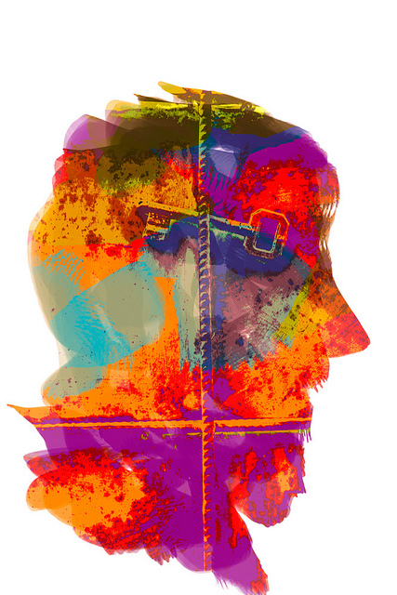
Curse of Knowledge: Theory of Mind Test for Adults
Pretend you are research participants in the study by Birch & Bloom (2007)… how would you answer the question?
Results indicate that…
Notes:
Activity: Curse of Knowledge: Theory of Mind Test for Adults
Time: 10 minutes
Materials: A copy of Birch, S.A. & Bloom, P. (2007). The curse of knowledge in reasoning about false beliefs. Psychological Science, 18(5), 382-386.
A copy of this article may be found at this address: http://www.yale.edu/minddevlab/papers/birch&bloom%20curse.pdf
Directions:
Students are asked to pretend that they were research participants in this study; they listen to the story vignette and respond as if they were participants (by indicating what is the probability that the character will look in each possible location first)
Next, the instructor explains what the researchers found
Students are then asked two discussion questions:
Were you surprised by the results? Why or why not?
Discuss how even adults are not always very good at theory of mind
How might this bias impact social interactions in the real world?
Discuss how people tend to think they understand the minds of others better than they actually do; can discuss how this impacts interpersonal relationships, work interactions, diplomatic relations, etc.
Additional Possible Discussion Question:
Think back to the last time you experienced a conflict. Explain what happened in terms of theory-of-mind concepts. How was the conflict resolved?
This question is aimed at helping students review the components of ToM and relate them to personal experiences. It also helps show how we often think that we understand others’ thinking but we don’t

Slide 20
Overview
What Is Theory of Mind (ToM)?
Why Do We Need ToM?
How Is ToM Different in Individuals with Autism?
What Processes Comprise ToM?
How Do People Explain Others’ Behavior?
Notes:
Mid-Lecture Overview: So, those are the component parts. Let’s talk next about how this works in action as people go about their day to day lives.

Slide 21
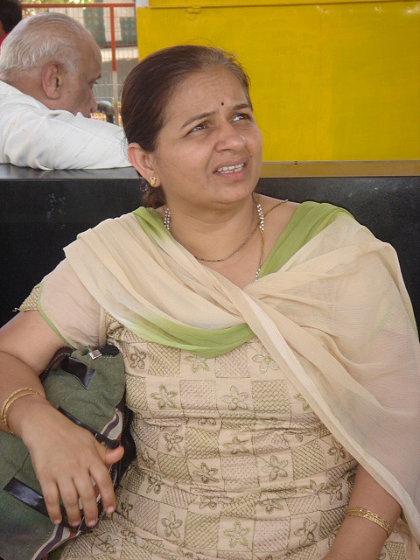
People’s Explanations of Behavior
Need to ask why
Why is the teenager wearing that outfit?
Why is he being so nice?
Why did the murderer kill those people?
Notes:
The purpose of this slide is to discuss people’s explanations of other’s behavior
(Click): Need to ask why
(Click): Why is the teenager wearing this outfit?
(Click): Why is he being so nice?
(Click): Why did the murder kill those people?
People have a tendency to try to find explanations for why people are doing what they are doing. This reflects the automatic nature of theory of mind in every day life. Whenever a behavior is observed, people tend to automatically try to come up with a mental explanation for it. This helps people make sense of the world (which might otherwise seem like a random series of movements and responses).

Slide 22
Activity: Theory of Mind in Action
Directions:
  Observe Social Interactions
  Complete Observation Chart
Describe observed behavior (without using mental terms) | Explain the underlying cause for this behavior (using ToM terms)
Notes:
Activity: Theory of Mind in Action
Theory of Mind in Action
Time: 15 minutes
Materials: Observation chart
Directions:
Students could do this activity during class time or as a homework assignment
Students will complete an observation – this would ideally be done in live setting but it could also be done while watching a TV show or a movie.
Students’ task is to complete an observational chart in which they practice separating the observed behavior from the interpreted underlying meaning.
Discussion questions following the completion of the observation:
How easy was it to separate observing overt behaviors from interpreting them? What does this suggest about theory of mind?
Use student responses to discuss the automatic nature of theory of mind
What elements of theory of mind did YOU use to complete this activity?
Use student responses to review the component processes in the hierarchy

Slide 23

CAT: The Muddiest Point
What was the muddiest point about today’s class?
Write down what concept you are still struggling to understand.
Notes:
Classroom Assessment Technique (CAT): The Muddiest Point
Ask students to write down the “muddiest point” – that is any concept they are still struggling to understand of any questions they still may have about the material. With remaining class time, ask students to share their muddiest point and provide additional review on these points.
If you do not conclude with this Classroom Assessment Technique (CAT), it would helpful to use another CAT. It could be in the form of a:
Muddy point
One-minute paper
Background knowledge
What’s the Principle?
Defining features Matrix:
For more information on CATs click here: http://cft.vanderbilt.edu/guides-sub-pages/cats/

Slide 24
Photo Attribution
Slide 1 | Photo Credit: brain power Allan Ajifo https://www.flickr.com/photos/125992663@N02/14601014695 https://creativecommons.org/licenses/by/2.0/
Slide 5 | Photo Credit: Empathy ACLU of Southern California https://www.flickr.com/photos/aclu_socal/2604994533/ https://creativecommons.org/licenses/by-nc-nd/2.0/
Slide 7 | Photo Credit: Takeout or Dine In 002 Penn State https://www.flickr.com/photos/53130103@N05/4947508079/https://creativecommons.org/licenses/by-nc/2.0/
Slide 9 | Photo Credit: meeting new friends 3 Animals Asia https://www.flickr.com/photos/121330095@N07/14872455260/ https://creativecommons.org/licenses/by-nc/2.0/
Slide 10 | Photo Credit: Bus Stop Sit-Stay Transguyjay https://www.flickr.com/photos/75619356@N00/3440712104/ https://creativecommons.org/licenses/by-nc-sa/2.0/
Slide 13 | Photo Credit: DSC04449 tfxc https://www.flickr.com/photos/23964833@N08/13520376654/ https://creativecommons.org/licenses/by-nc-nd/2.0/
Slide 14 | Photo Credit: Mountain Rock Face Climber tpsdave https://pixabay.com/en/mountain-rock-face-climber-90780/ https://creativecommons.org/publicdomain/zero/1.0/deed.en
Slide 15 | Photo Credit: Mime in profile Brian Leon https://www.flickr.com/photos/ncbrian/3396608887/ https://creativecommons.org/licenses/by-nc-nd/2.0/
Slide 16 | Photo Credit: Part of the international family yooperann https://www.flickr.com/photos/99923398@N00/15370548727/https://creativecommons.org/licenses/by-nc-nd/2.0/
Slide 17 | Photo Credit: Throwing flowers at muses bricolage 108 https://www.flickr.com/photos/11922859@N00/164228715/ https://creativecommons.org/licenses/by-nc-sa/2.0/
Slide 19 | Photo Credit: The solution is... Nikos Gazetas https://www.flickr.com/photos/46411095@N07/6820957628/ https://creativecommons.org/licenses/by-nc/2.0/
Notes:
Photo Attribution Slide

Slide 25
Photo Attribution
Slide 21 | Photo Credit: Candid 3 Disha Gadhiya https://www.flickr.com/photos/38529649@N00/2351896207/ https://creativecommons.org/licenses/by-nc-nd/2.0/
Slide 23 | Photo Credit: Photo Credit: Illustrated silhouette of a black cat nehtaeh79 http://www.freestockphotos.biz/stockphoto/16624 http://creativecommons.org/publicdomain/zero/1.0/
Notes:
Photo Attribution Slide

